Slide 2


Slide 3
Lessons From the Prophet Isaiah
“Refocusing our Faith”
Isaiah 53:1-12

Slide 4


Slide 5
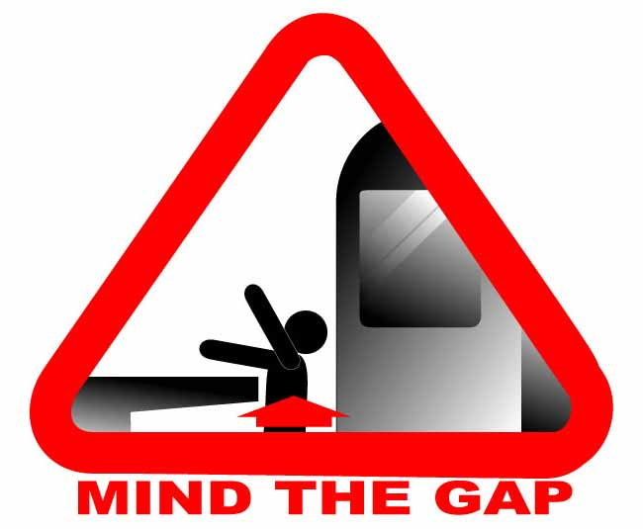

Slide 6
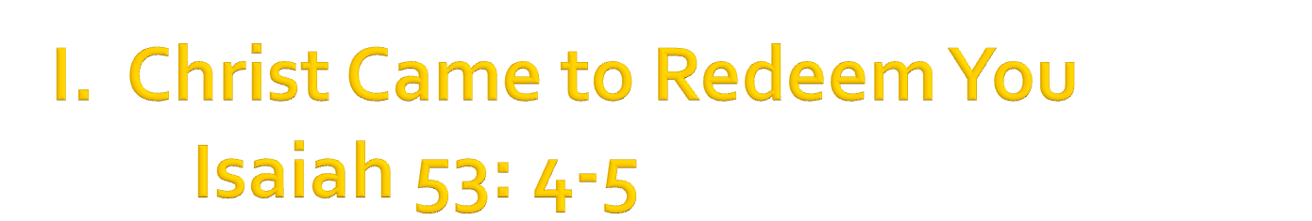

Slide 7
Christ came to redeem you from suffering
“Surely he took up our infirmities and carried our sorrows” (v4).

Slide 8
Christ came to redeem you from suffering
“Surely he took up our infirmities and carried our sorrows” (v4).
Christ came to redeem you from sin
“But he was pierced for our transgressions, he was crushed for our iniquities” (v5).

Slide 9
Christ came to redeem you from suffering
“Surely he took up our infirmities and carried our sorrows” (v4).
Christ came to redeem you from sin
“But he was pierced for our transgressions, he was crushed for our iniquities” (v5).
By sacrificing Himself as your substitute
“But he was pierced for our transgressions, he was crushed for our iniquities; the punishment that brought us peace was on him, and by his wounds we are healed” (v5).

Slide 10
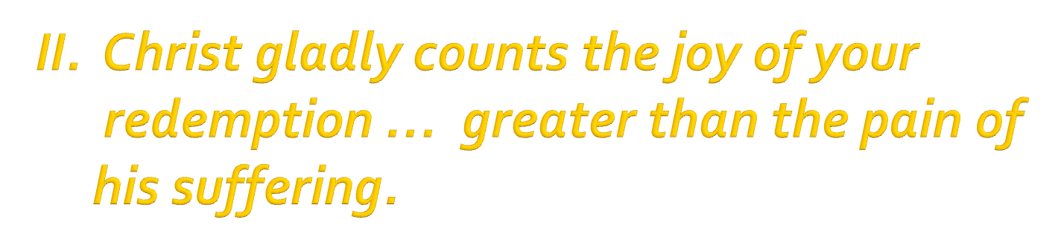
“After the suffering of his soul, he will see the light of life and be satisfied” (v11).

Slide 11
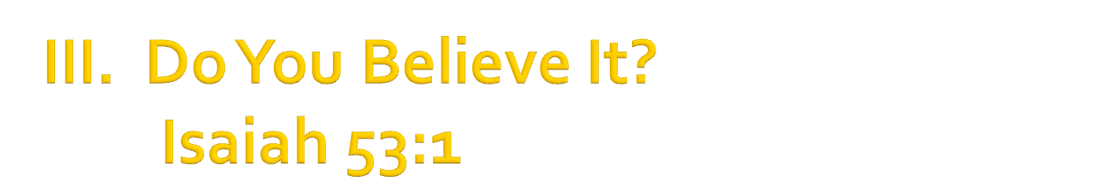
“Who has believed our message and to whom has the arm of the Lord been revealed?” (v1).

Slide 12
“Who has believed our message and to whom has the arm of the Lord been revealed?” (v1).
Preach the gospel to yourself every day
“The gospel is so foolish (according to my natural wisdom), so scandalous (according to my conscience), and so incredible (according to my timid heart), that it is a daily battle to believe the full scope of it as I should.”

Slide 13
Your Story in a Different Frame

Slide 14
Your Story in a Different Frame
The old frame
“He had no beauty or majesty to attract us to him, nothing in his appearance that we should desire him He was despised and rejected by men” (v2).

Slide 15
Your Story in a Different Frame
The old frame
“He had no beauty or majesty to attract us to him, nothing in his appearance that we should desire him He was despised and rejected by men” (v2).
The new frame
“We all, like sheep, have gone astray, each of us has turned to his own way; and the LORD has laid on him the iniquity of us all” (v6).

